Slide 1
11 NOVEMBER 2022 PRIMARY 6 GAMES DAY

Slide 2
Rationale Build Class camaraderie Challenge yourselves in sports

Slide 3
Games day Timeline
08:00 am – 11:00 am | P6 interclass
11.00Am – 11.20Am | Teachers vs Students
11.20Am – 11.30AM | Prize Giving
11:30am – 12.00pm | Recess
12.00pm – 01.30pm | Career festival

Slide 4
Event SCHEDULE
08:00 am – 08:10 am | Safety brief
08.10Am – 09.20Am | Interclass gameplay
09.20Am – 09.30AM | Movement to next venue
09:30am – 09.40am | Safety brief
09.40am – 10.50am | Interclass gameplay

Slide 5
Event SCHEDULE
10:50 am – 11:00 am | Movement to MPH
11.00Am – 11.20Am | TEACHERS VS STUDENTS
11.20Am – 11.30AM | PRIZE GIVING
11:30am – 12.00pm | Recess
12.00pm – 01.30pm | Career Festival

Slide 6
Classroom @ 730am
Teachers will split you into groups. (A1, A2, A3, B1, B2, B3)
Groups A1, A2, A3 WILL REPORT TO ISH AFTER FLAG RAISING.
GROUPS B1, B2, B3 WILL REPORT TO MPH (LVL2) AFTER FLAG RAISING
BRING YOUR RECESS ITEMS AND WATER BOTTLE

Slide 7
AT MPH/ ISH
PLACE YOUR VALUABLES IN CONTAINERS DESIGNATED FOR YOUR CLASS
SIT ACCORDING TO YOUR GROUPS AT DESIGNATED AREAS PRESCRIBED BY GAME MASTERS
Briefing begins at 8am sharp
Changeover to the next venue at 920am

Slide 8
Games day Flow
8.00am – 9.30am
A @ISH
B @MPH
9.30am – 11.00am
A @MPH
B @ISH
11.00am – 11.30am
All Classes @MPH

Slide 9
P6 Games

Slide 10
Venue Flow
Staircase 2
(Stairs from Uncle Raj’s Stall)
MPH
ISH
Staircase 5
(Spiral Staircase)

Slide 11

4 v 4 Volleyball @MPH
6RP
6CA
6GR
6RS
6IN

Slide 12
4 v 4 Volleyball @MPH (Ms Cassie)
Students will rotate within their detail with 4 active players and 2 substitutes.
The first team to reach 21 points will win the set. (or when time is up.)
Game time: 10 mins
Game begins from service line with max 3 touches before sending over.
Students are allowed to make 1 catch within their 3 touches.
Win = 5 pts, Draw = 2 pt, Lose = 1 pt

Slide 13



Service Zone

Slide 14


Slide 15
2 Serve Attempts
2nd Serve Allowed

Slide 16
Min 2 Touches before sending ball over
Min 2 Touches /
no self-toss to hit allowed.
Catch & Spike

Slide 17
No Self Toss and Hit
No self-tossing to hit allowed.
Catch & Toss
Catch & Hit

Slide 18
Toss to teammate after catching
Catch & Toss
Dig/ Set/ Spike

Slide 19
Catch & Toss
Set
Dig/ Set/ Spike
Max 3 Touches allowed

Slide 20
No 2nd Catches allowed.
Catch & Toss
Catch & Spike
Max 1 Catch allowed

Slide 21
No 2nd Catches allowed.
Catch & Toss
Catch & Toss
Dig/ Set/ Spike
Max 1 Catch allowed

Slide 22
Blocking allowed provided net is not touched
Block
Blocking is allowed

Slide 23
6IN
6RP
4 v 4 Captain’s ball @ISH (MR Thomas wong)
6GR
6RS
6CA

Slide 24
4 v 4 Captain’s ball @ISH (MR Thomas wong)
Students will rotate within their detail with 4 active players and 2 substitutes.
The first team to reach 11 points will win the set. (or when time is up.)
Game time: 10 mins (Swap sides after 4 mins)
Maximum of 1 receiver at Goal Zone*

Slide 25
4 v 4 Captain’s ball @ISH (MR Thomas wong)
Students must make at least 3 passes before scoring in the end zone.
Conditions:
Propelling ❌
Interception ✓
Tackling ❌
Receiver in end zone must catch the ball with both feet in the zone for the score to be valid.
Win = 5 pts, Draw = 2 pt, Lose = 1 pt

Slide 26
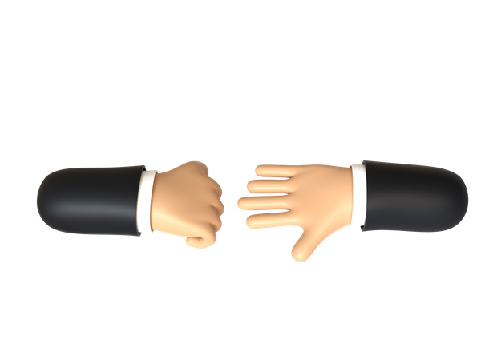
Rock Scissors Paper to start off
Start ball from scoring zone (rock paper scissors)

Slide 27
Bounce Pass Allowed

Slide 28
No Propelling
Not allowed to move more than 1 step with the ball

Slide 29
Min 3 passes
Change of Possesion
Minimum 3 passes before scoring after every change of possession

Slide 30

Both Feet in Scoring Zone

Slide 31
Both Feet in Scoring Zone

Slide 32
Out of Bounds Ball
No direct scoring from Out of Bounds Zone

Slide 33
Out of Bounds Ball
Indirect scoring

Slide 34
1 Receiver in Scoring Zone
Maximum 1 receiver in Scoring Zone

Slide 35
1 Receiver in Scoring Zone
Maximum 1 receiver in Scoring Zone

Slide 36
After Scoring
Team that did not score will start ball from scoring zone

Slide 37
At HALF TIME (4 Mins)
Teams will swap scoring zone after half time (4 mins)

Slide 38


